Slide 1

INF554 Data Challenge : Retweet Prediction
Team name : Retweet
By : Laychiva CHHOUT, Vannvatthana NORNG

Slide 2

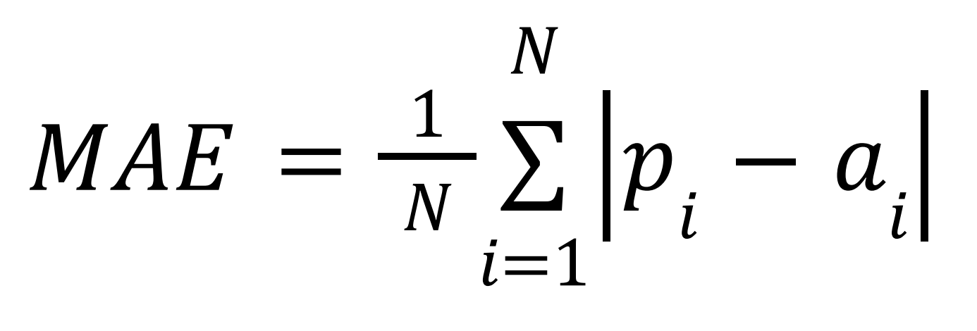
Objective
Build a ML model to predict the number of retweets
Compete with other teams
Using MAE for evaluation

Slide 3
Datasets
2 datasets are given : training and evaluation datasets
training dataset : 353 969 data with 12 features given
TweetID
timestamp
retweets_count
verified
statuses_count
followers_count
evaluation dataset : same except no retweets_count!
240 744 data
Friends_count
mentions
urls
hastags
favorites_count
text

Slide 4
Features choice
2.) 4 new features created from the existing ones:
1.) 6 features chosen (excluding TweetID, retweets_count)
favorites_count
followers_count
verified
statuses_count
friends_count
timestamp
From text : we created len_text for the length of strings of the text because the longer the tweet, the more retweets it receives
From timestamp :
weekend (day of the week) : assign numbers for each day
(1 = Monday, … ,7 = Sunday)
cos, sin : assign the value of cos(α) and sin(α) for each tweet posted in 24h where
α = (num of seconds from 00:00 until the time it is posted * 2π) / (num of seconds in a day)

Slide 5
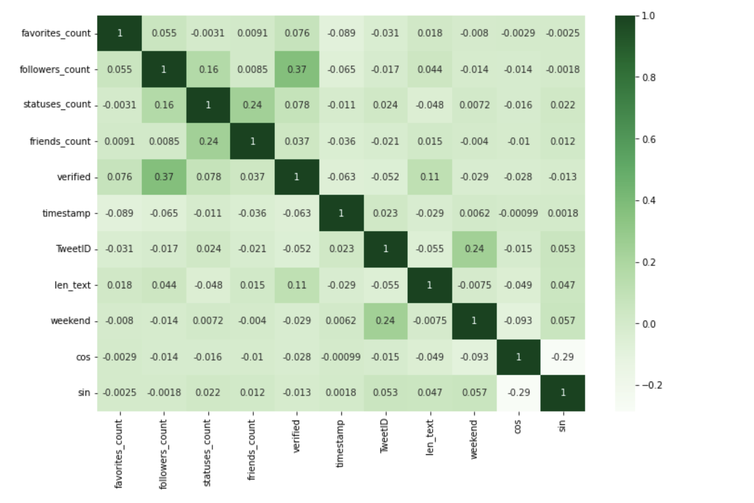
Correlation matrix of features
Each feature is independent from the others !

Slide 6
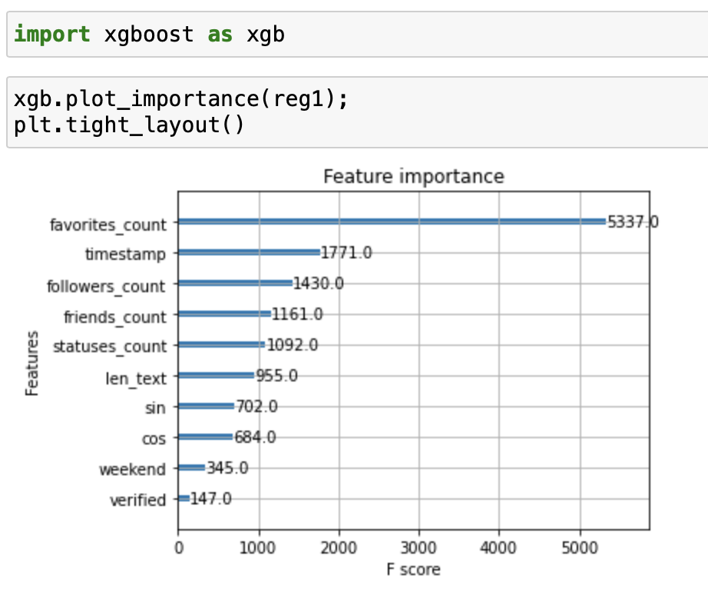

Slide 7

Model Choices
5 Models of regression are considered :
Linear
Extreme Gradient Boosting (XGB)
Gradient Boosting
Decision Tree
Random Forest.

Slide 8
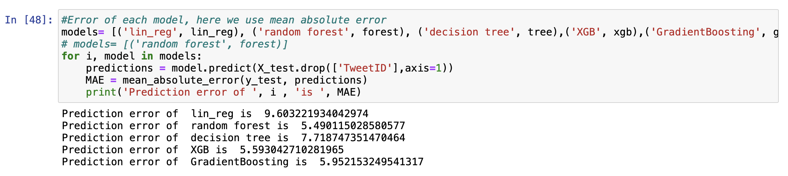
MAE comparison Before tuning
RandomForest (MAE ≈ 5.49) and XGB (MAE ≈ 5.59) are the models with best performances
Hyperparameters Tuning

Slide 9
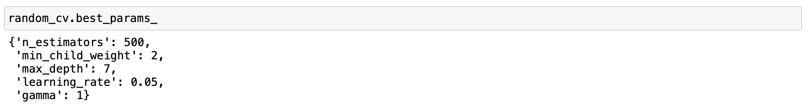
Hyperparameters Tuning
We use RandomizedSearchCV with cv = 3 (3-fold splitting strategy) for hyperparameters tuning of both models.
XGB regressor :
Important parameters : n_estimators, max_depth, learning_rate, gamma and min_child_weight
Use “parameter narrowing” and tune one parameter at a time, we got this result
It took much less time for tuning than Random Forest.

Slide 10
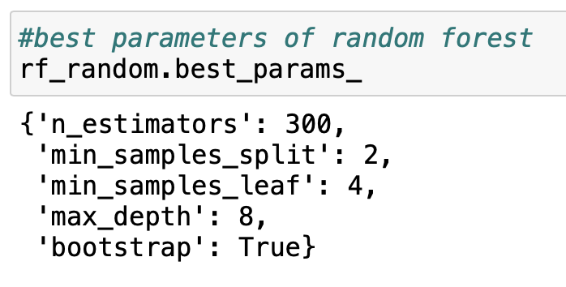
Random Forest :
Important parameters : n_estimators, max_depth, min_samples_split, min_samples_leaf, and bootstrap.
Same as XGB, we use parameter narrowing and tune one parameter at a time.
We got this result :
It took too much time to execute due to the complexity of the model.

Slide 11
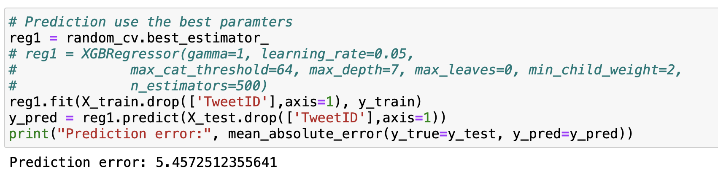
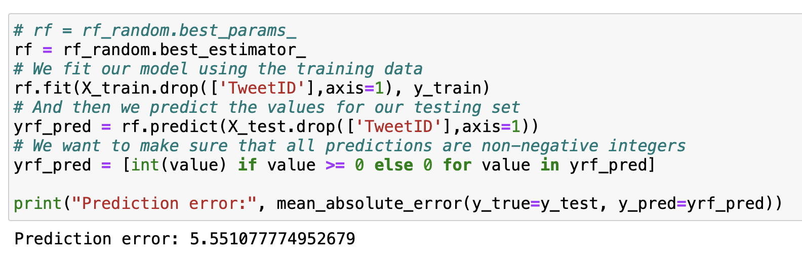
Final Comparison
XGB is the choice because :
More accurate (MAE ≈ 5.457) compared with RandomForest (MAE ≈ 5.551)
Take less time to execute
MAE of models XGB (top) and Random Forest (bottom)

Slide 12
Thank you for your attentions!

